Slide 1
Introduction to Time Series Analysis & Applications
BIG Summer Hackathon
July 18, 2020
Katherine Sheu
katherinesheu@ucla.edu

Slide 2
Time series data is everywhere!
Can you guess what this is describing?
TSA, 4th Edition, Shumway & Stoffer

Slide 3
Time series data is everywhere!
TSA, 4th Edition, Shumway & Stoffer

Slide 4
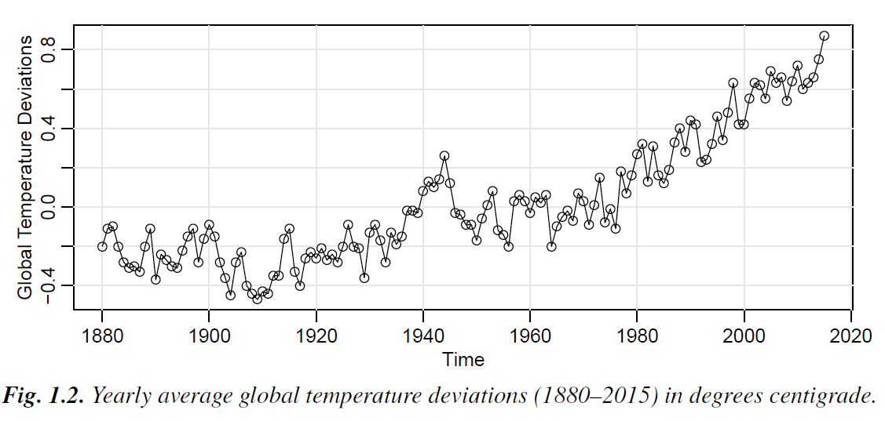
Time series data is everywhere!
Could have also been global warming
TSA, 4th Edition, Shumway & Stoffer

Slide 5
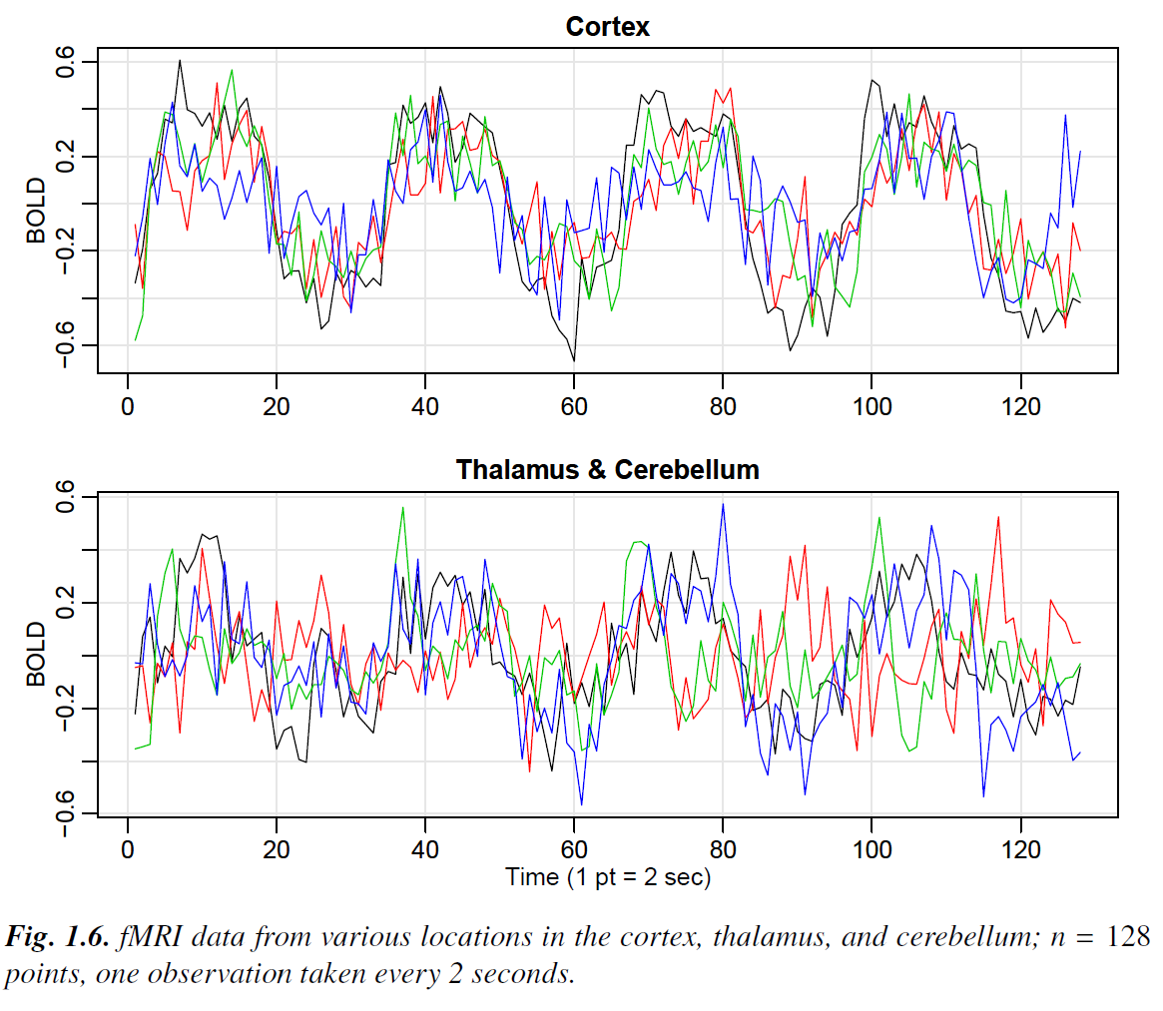
Time series data is everywhere!
What is this describing? – More clues left on this one..

Slide 6
Time series data is everywhere!

Slide 7
Time series datasets can display correlations
TSA, 4th Edition, Shumway & Stoffer

Slide 8

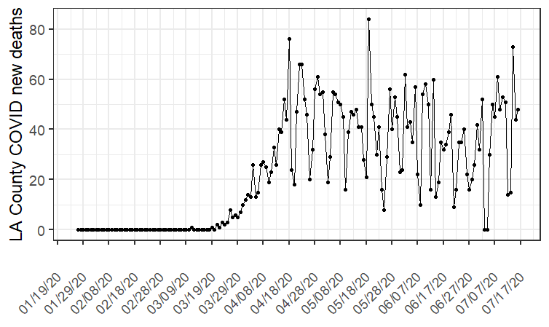
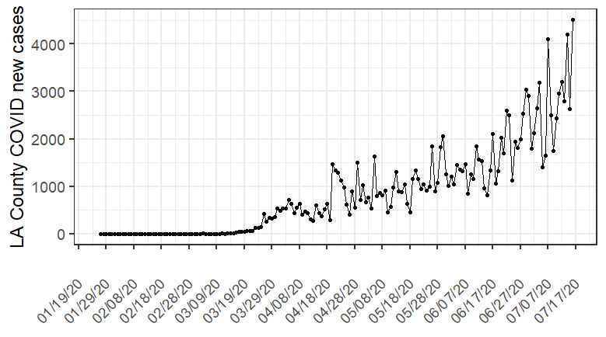
Another example relevant to LA County
Notes:
Data downloaded from https://github.com/datadesk/california-coronavirus-data

Slide 9
The Nature of Time Series Data
Characteristics of Time Series Data
A dataset observed at different points in time (seconds, months, days, years)
A collection of random variables indexed according to the order they are obtained in time
Sampling of adjacent points in time restricts the applicability of the many statistical methods that assume observations are independent and identically distributed
What is Time Series Analysis?
Systematic mathematical and statistical approaches used to answer questions posed by time correlations
Goal: to develop mathematical models that provide plausible descriptions for sample data

Slide 10
Outline
Importing time series data (in R)
Signals and noise
Moving averages and filtering
Time series statistical models
Stationary vs non-stationary
Forecasting with time series data
Classical time series regression models, versus
ARIMA (autoregressive integrated moving average) models

Slide 11
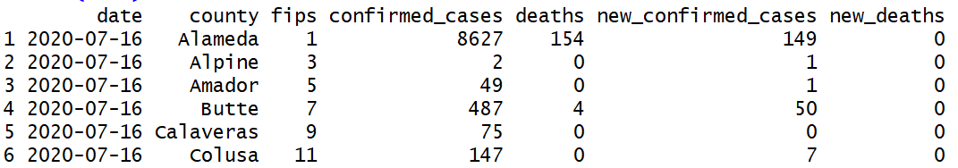
Importing time series data
> library(ggplot2)
> #read/view data----
> data = read.csv("latimes-county-totals.csv")
> data$date = as.Date(data$date)
> head(data)
Notes:
#plot LA county----
ggplot(data[grepl("Los Angeles", data$county),], aes(date, new_deaths))+geom_point()+geom_line()+
scale_x_date(name = '', date_breaks = '10 days', date_labels = '%D')+ #label x-axis every 10 days
theme_bw(base_size = 18)+theme(axis.text.x = element_text(angle = 45, vjust = 0.5, hjust=1))+
ylab("LA County COVID new deaths")

Slide 12
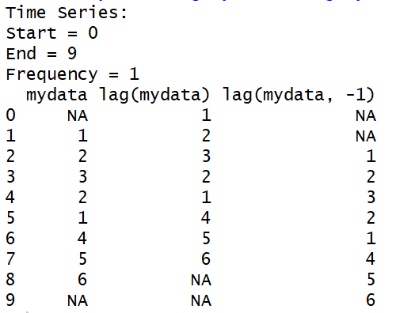
Bonus: Time Series Primer for R
You can use the package “astsa”
#Applied Statistical Time Series Analysis
Use the command ts to create a time series object
> (mydata = c(1,2,3,2,1,4,5,6) ) #make a small dataset
> (mydata = as.ts(mydata) ) #make it a timeseries object
> cbind(mydata, lag(mydata), lag(mydata,-1))
#calculate lags, shifts the index of your values forward or backward

Slide 13
Signals in noise
Often patterns in time series data are contaminated by a random noise
> # filtering example----
> w = rnorm(500,0,1) # 500 N(0,1) variates
> v = filter(w, sides=2, filter=rep(1/3,3)) # moving average
> plot.ts(w, main="white noise")
> plot.ts(v, ylim=c(-3,3), main="moving average")
TSA, 4th Edition, Shumway & Stoffer

Slide 14
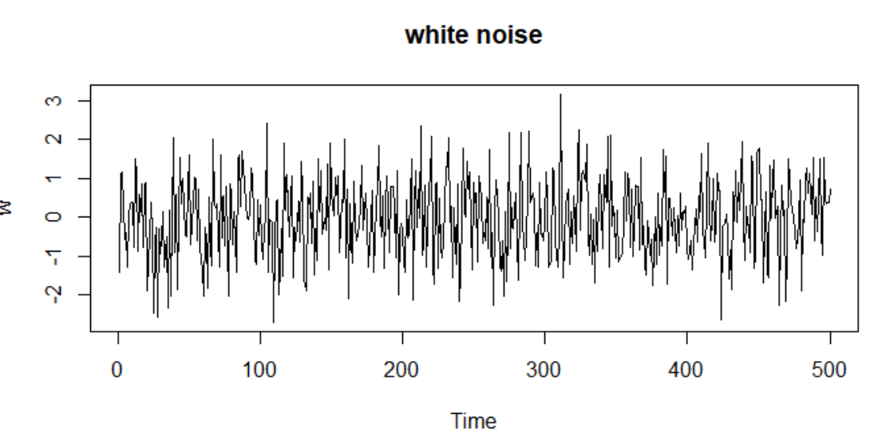
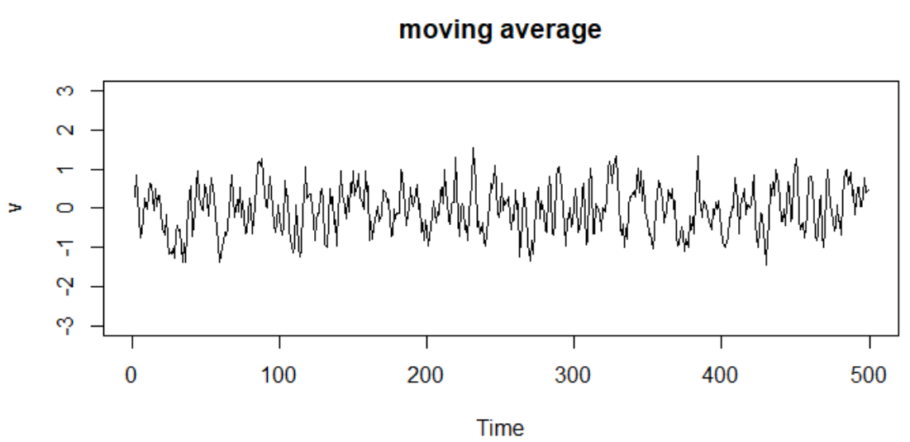
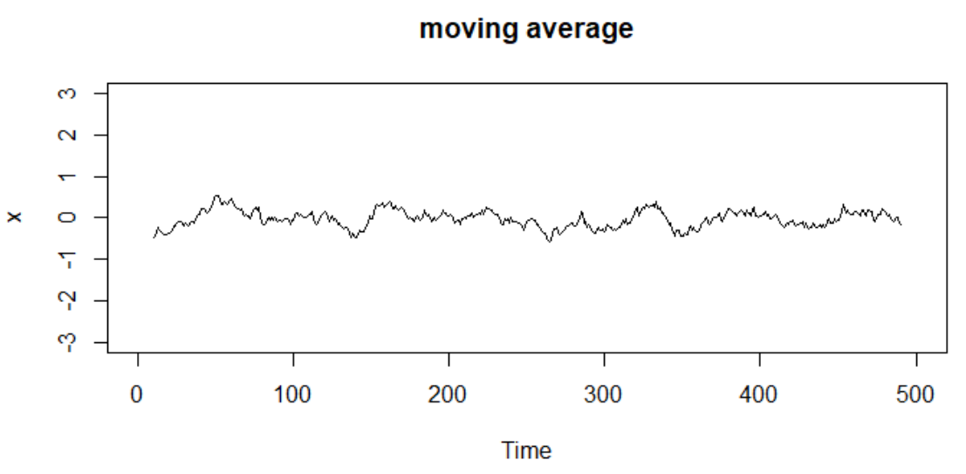
filter
Use the filter function to adjust the moving average
> v = filter(w, sides=2, filter=rep(1/3,3)) # moving average
> x = filter(w, sides=2, filter=rep(1/20,20)) # moving average

Slide 15
Other moving average and smoothing options
Kernel smoothing is a moving average smoother that uses a weight function, or kernel, to average the observations
> #other smoothers
> z = as.ts(v)
> plot(z)
> lines(ksmooth(time(w), w, "normal", bandwidth=1), lwd=2, col=4)
> lines(lowess(z), lty=2, lwd=2, col=2) # trend (with default span)
> lines(smooth.spline(time(z), z, spar=.5), lwd=2, col=4)

Slide 16
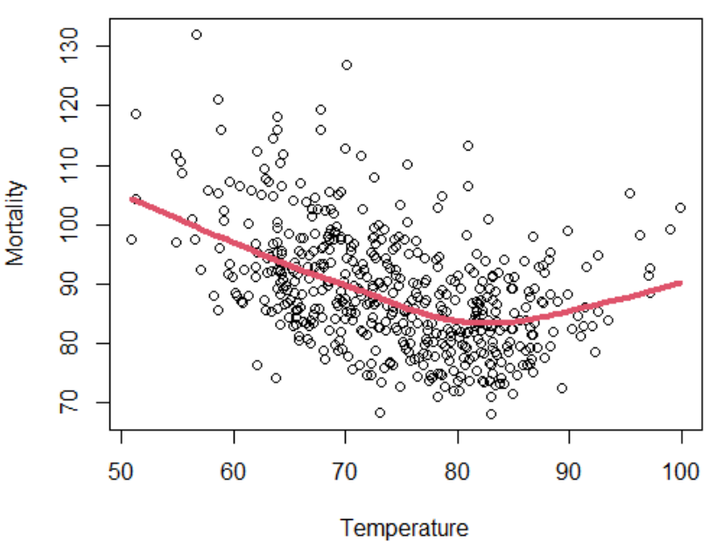
Smoothing relationships between two time series
LA County heart disease deaths
> library(astsa)
> plot(tempr, cmort, xlab="Temperature", ylab="Mortality")
> lines(lowess(tempr, cmort), col=2)

Slide 17
Measures of Dependence
A main feature of time series data
observations measured through time are dependent on each other
How to quantify the amount of dependence?
Autocorrelation - the similarity between observations given some time lag between them
Autocovariance – the covariance of between pairs of timepoints

Slide 18
Time series statistical models
Classical multiple linear regression in a time series context
Need for stationary time series & Preprocessing nonstationary time series
Concepts of detrending and differencing
Autoregressive models, parameter estimation, and forecasting

Slide 19
Classical regression in a time series context
Some measurement output x_{t} (dependent variable) is influenced by a bunch of inputs z_{t} (independent variables)
β’s are the regression coefficients,
w is the white noise

Slide 20
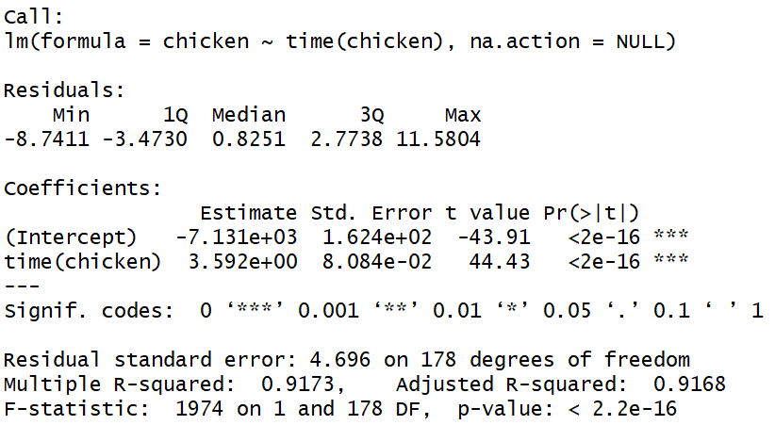
The chicken prices example
> summary(fit <- lm(chicken~time(chicken), na.action=NULL)) #from astsa

Slide 21
Measures for how well the model fits (ie. goodness of fit)
Akaike’s Information Criterion (AIC)
Bayesian Information Criterion (BIC)
> summary(fit <- lm(chicken~time(chicken), na.action=NULL))
> num = length(chicken) # sample size
> AIC(fit) # AIC, smaller the better
[1] 1071.651
> BIC(fit) # BIC
[1] 1081.23

Slide 22
Stationary vs non-stationary time series
With time series data, it is the dependence between the values of the series that is important to measure (ie. want to be able to estimate autocorrelations)
It would be difficult to measure that dependence if the dependence structure is not regular or is changing at every time point
So, to achieve any meaningful statistical analysis of time series data, it is crucial that, if nothing else, the mean and the autocovariance functions satisfy the conditions of stationarity (for at least some reasonable stretch of time)

Slide 23
Most examples we’ve looked at are non-stationary
Chicken prices, global warming, COVID deaths
We can manipulate the data to play down the effects of nonstationarity uncover the stationary properties of the series.
Easiest form of nonstationarity to work with is the trend stationary model where the process has stationary behavior around a trend.

Slide 24
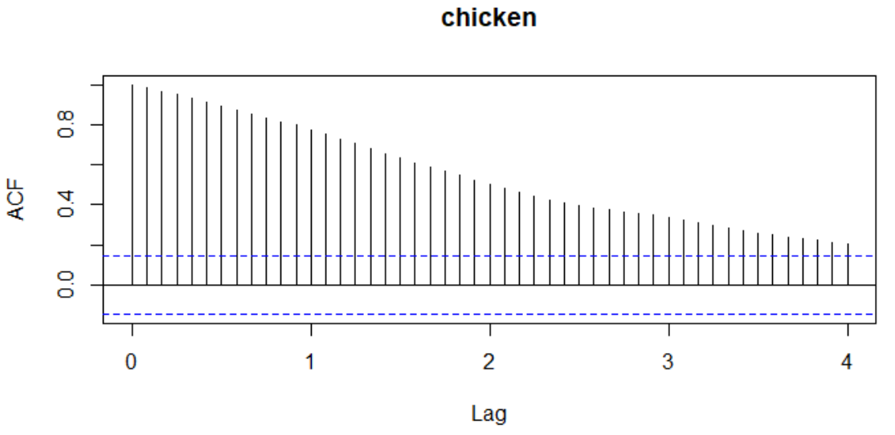
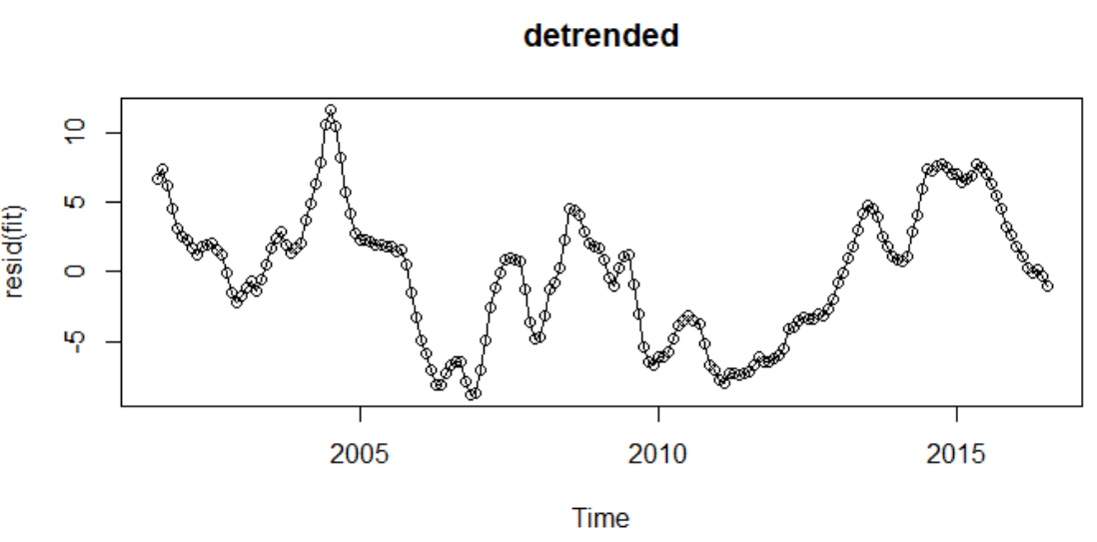
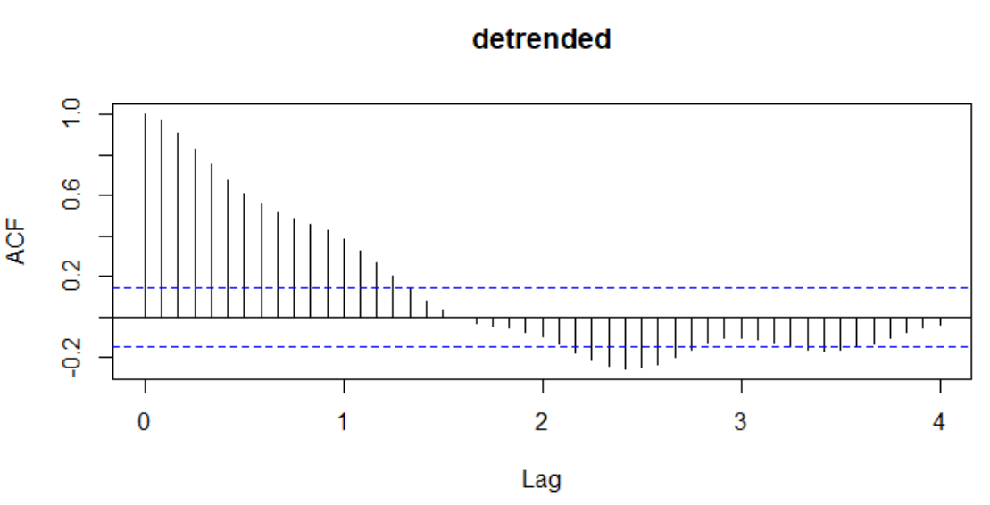
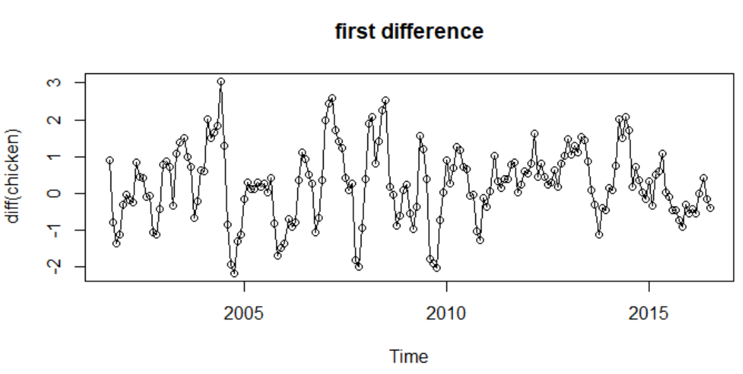
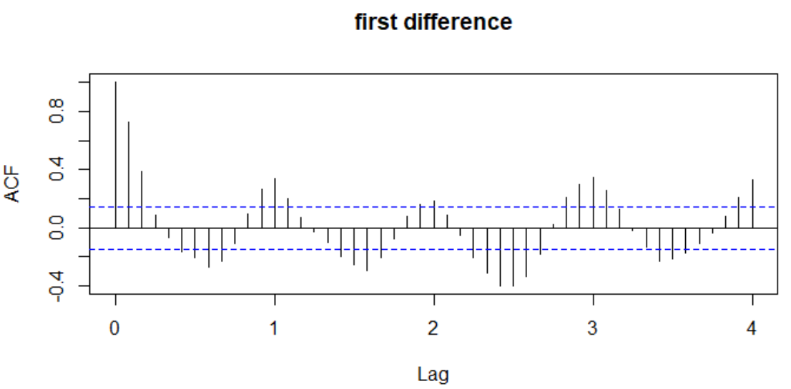
Detrending and differencing chicken prices

Slide 25
Detrending vs differencing intuition
They produce difference results
the differenced series does not contain the long (five-year) cycle we observe in the detrended series
differenced series exhibits an annual cycle that was obscured in the original and detrended data
No parameter estimation needed in differencing
However, differencing does not estimate y_{t} (output)
> #detrending and differencing chicken example----
> plot(resid(fit), type="o", main="detrended")
> plot(diff(chicken), type="o", main="first difference")
>
> #finding the autocorrelation patterns
> acf(chicken, 48, type = "correlation", main="chicken")
> acf(resid(fit), 48, type = "correlation", main="detrended")
> acf(diff(chicken), 48, type = "correlation", main="first difference")

Slide 26
Using and understanding the ACF
the autocorrelation function tells us whether a substantial linear relation exists between the series and its own lagged values

Slide 27
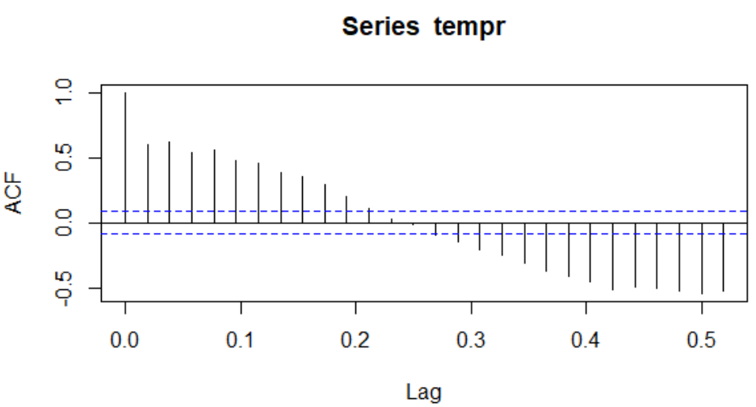
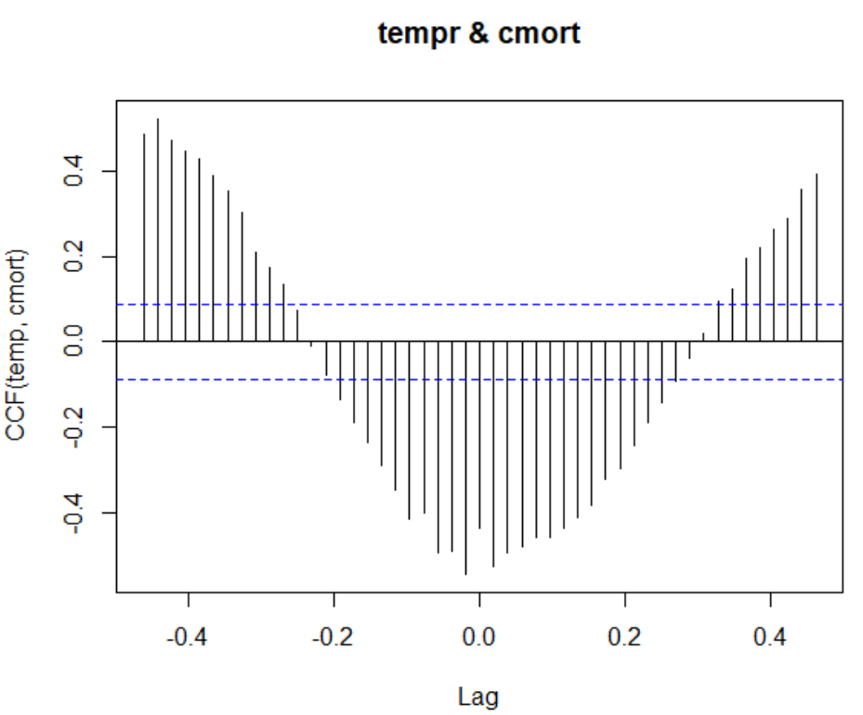
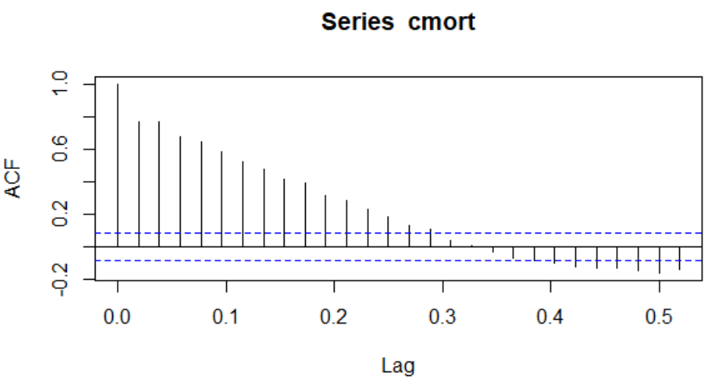
Using and understanding the ACF
Use the cross-correlation function to compare lag between two series
> acf(tempr)
> acf(cmort)
> ccf(tempr, cmort, ylab="CCF(temp, cmort)")

Slide 28
ARIMA models
Classical regression is often insufficient for explaining all of the interesting dynamics of a time series
For example, the ACF of the residuals of the simple linear regression fit for chicken prices reveals additional structure that regression did not capture
1951 – Autoregressive models (AR)
1951 – Autoregressive moving average models (ARMA)
1970 – Autoregressive integrated moving average models (ARIMA)

Slide 29
Box–Jenkins method for identifying ARIMA models
ARIMA models are a broader class of models that allow for modeling non-stationary data after transformation (eg. differencing)
techniques for parameter estimation and forecasting using these models
Parameter estimation – involves choosing the correct/best model based on present data
Forecasting – involves using that model to get future values

Slide 30
Steps for fitting an ARIMA model to time series data
• plotting the data,
• possibly transforming the data,
• identifying the dependence orders of the model,
• parameter estimation,
• diagnostics, and
• model choice

Slide 31
ARIMA model building
three numbers p, d, q specifies an ARIMA model
p represents the autoregressive part (AR)
d represents the integrated part (I) (differencing)
q represents the moving average part (MA)
We need to first check the stationarity of the data
If stationary, d=0. If you take the difference once, d=1.
Keep taking the difference until the data is stationary.
Get p and q by inspecting the ACF plots
Once we have the “order” of the model (defined by p, d, q), then we can estimate parameters

Slide 32
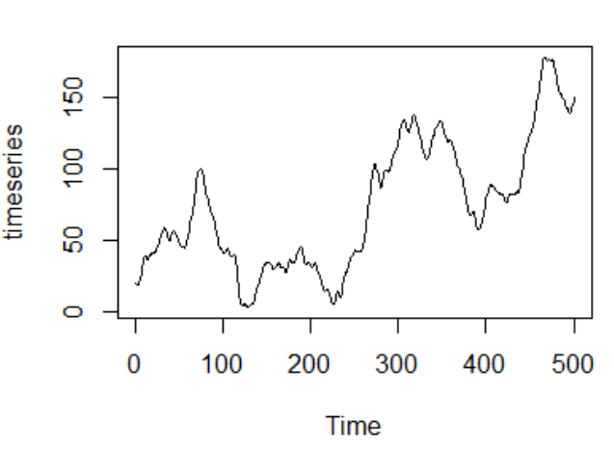
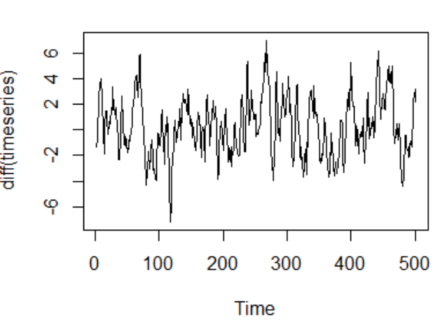
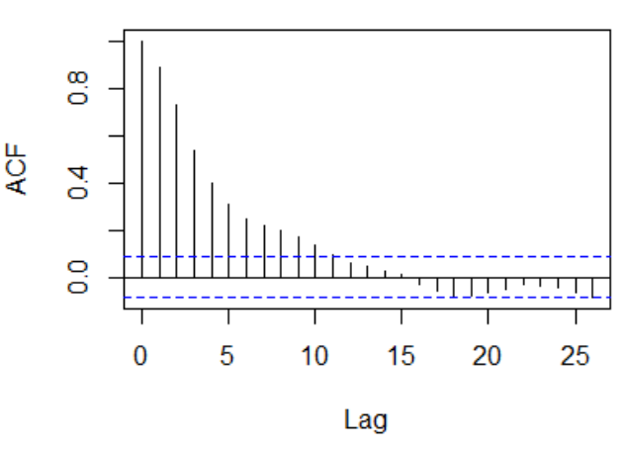
An example in R
> # arima example in R----
> set.seed(123)
> timeseries=arima.sim(list(order = c(1,1,2), ma=c(0.32,0.47), ar=0.8), n = 500)+20
> #PLOT the data
> plot.ts(timeseries)
> #do the differencing and check the ACF plot
> plot.ts(diff(timeseries))
> acf(diff(timeseries))
Read more at https://rpubs.com/riazakhan94/arima_with_example

Slide 33
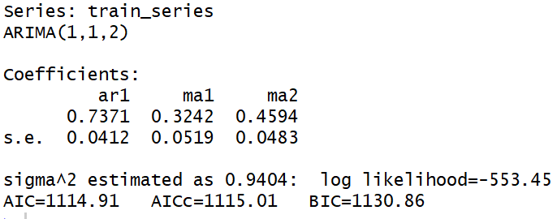
An example in R – selecting and parameterizing a model
> # partition into train and test
> train_series=timeseries[1:400]
> test_series=timeseries[401:500]
> #DOING IT AUTOMATICALLY WITH THE PACKAGE----
> library(forecast)
> AutoArimaModel=auto.arima(train_series)
> AutoArimaModel

Slide 34
Forecasting: time series analysis and projection
In forecasting, the goal is to predict future values of a time series, x_{n+m}, m = 1, 2, …, are future points,
based on the data points collected to the present, x_{1:n} = {x₁, x₂, …, x_{n}}.
we assume x_{t} is stationary and the model parameters are now known

Slide 35
Example of forecasting

Slide 36
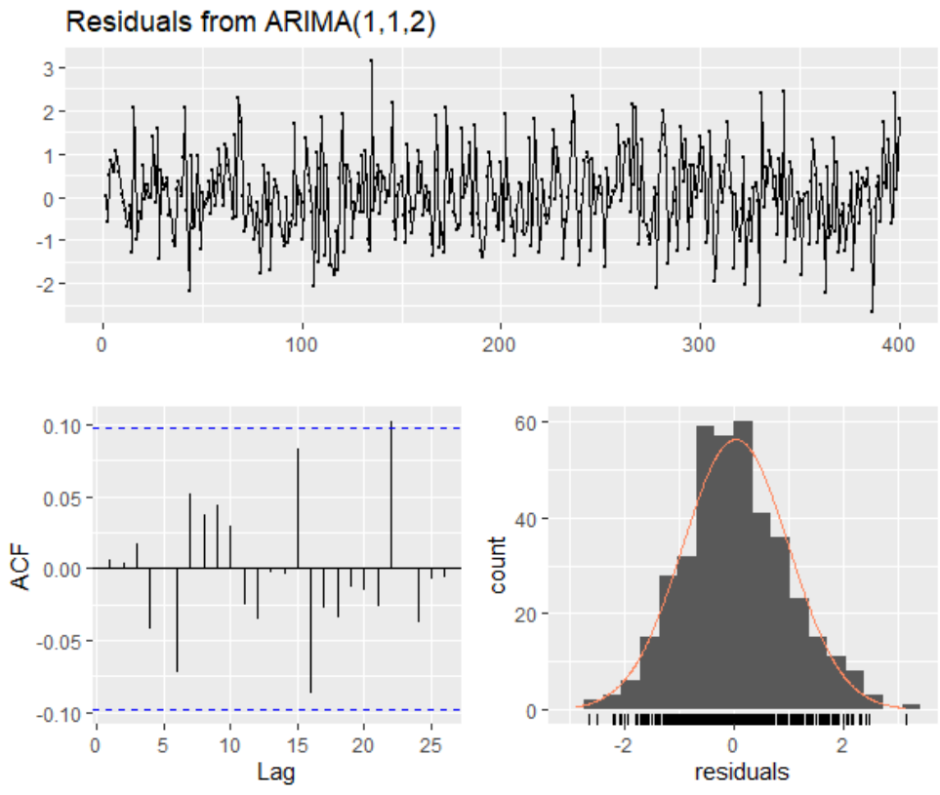
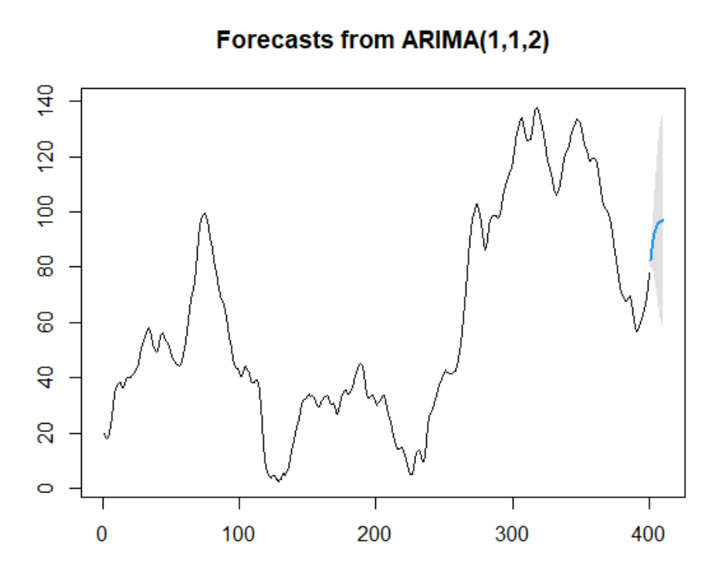
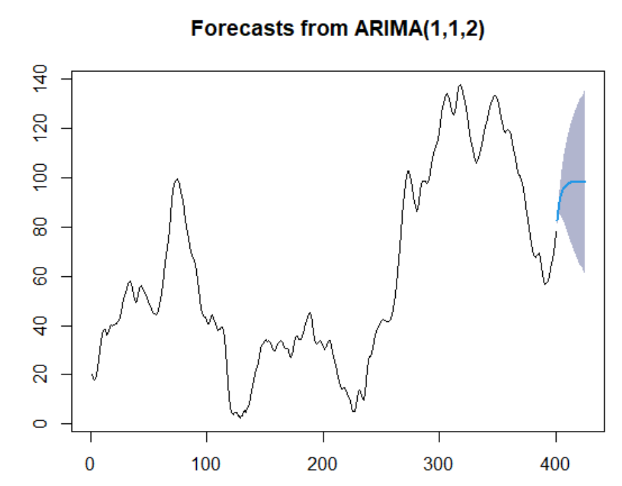
An example in R – using the model to forecast
> #forecasting
> futurVal <- forecast(AutoArimaModel,h=10, level=c(99.5))
> futurVal <- forecast(AutoArimaModel,h=50, level=c(80)) #adjust timesteps ahead, and confidence level
> plot(futurVal)
> checkresiduals(AutoArimaModel)

Slide 37
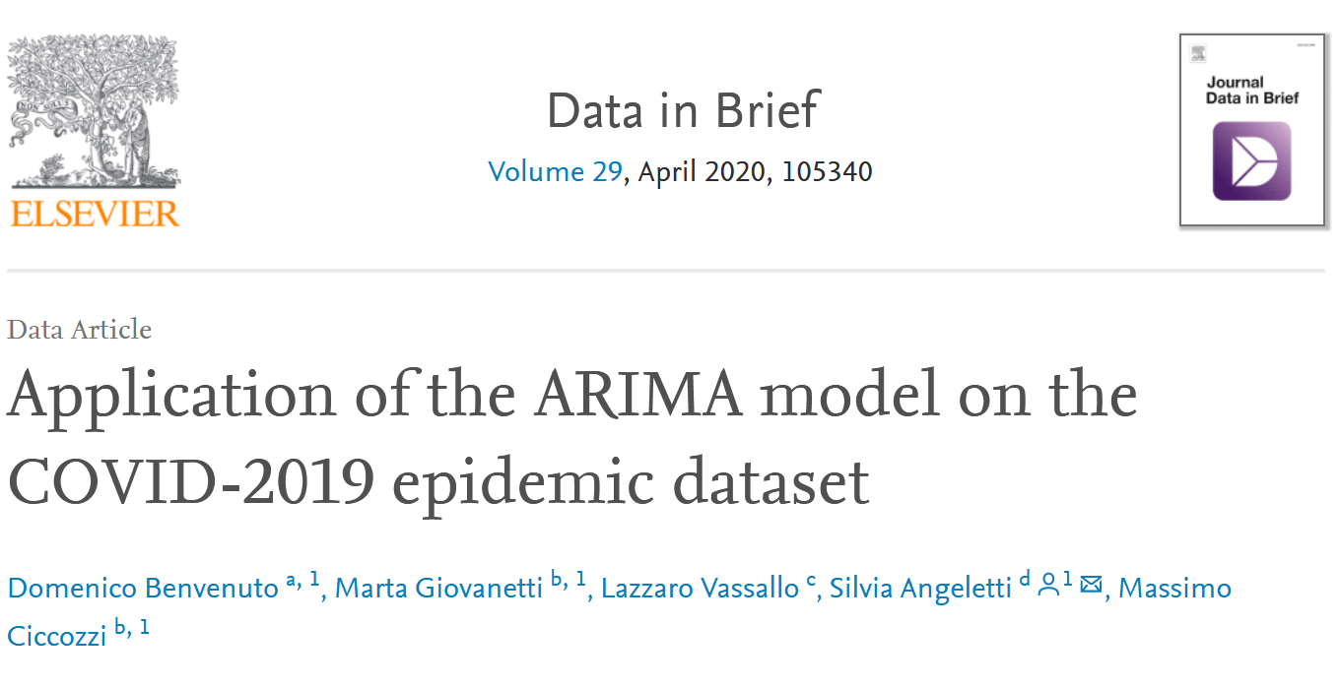
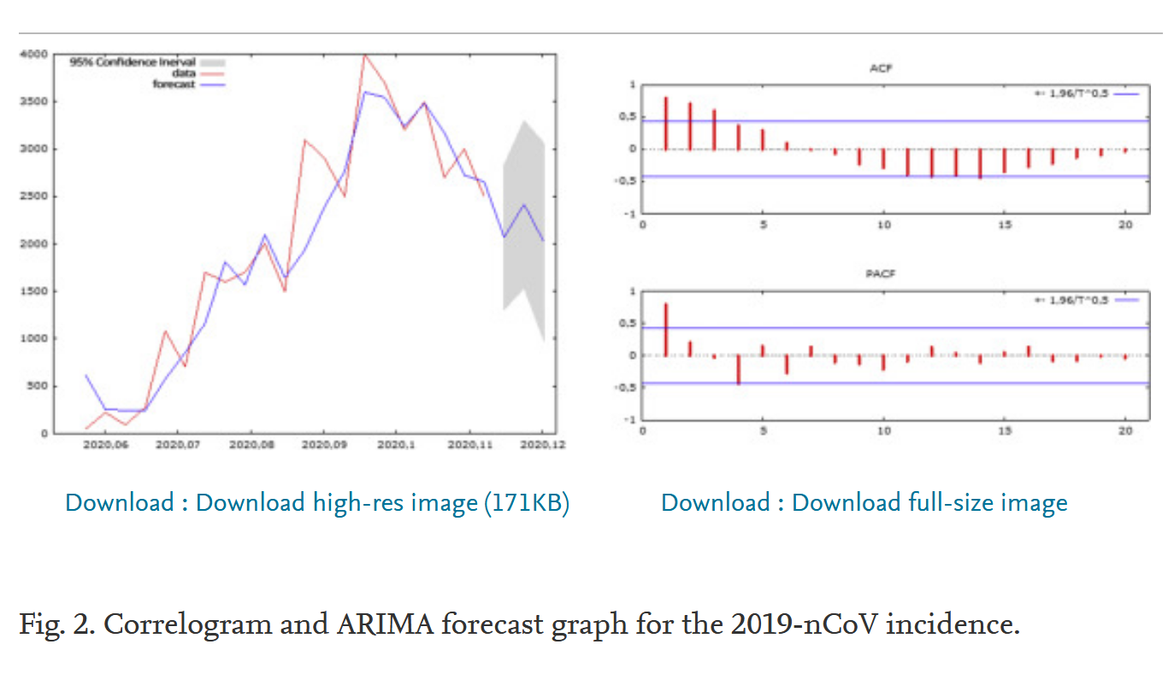

Slide 38

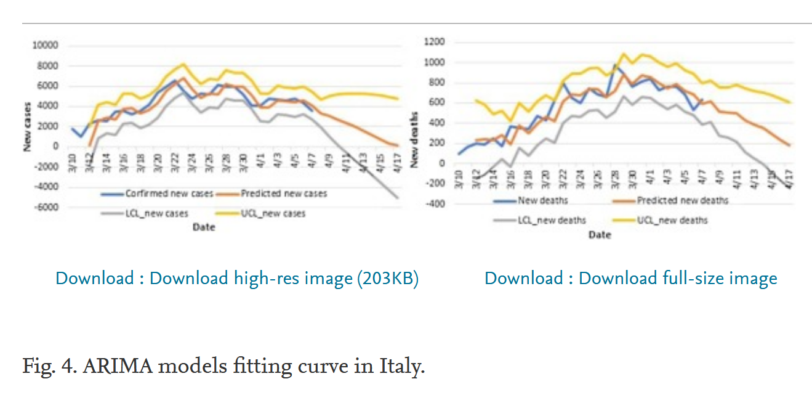

Slide 39
Summary and other ideas
Lots of interesting patterns in time series data!
Real world data has noise
There are patterns beyond the main trends
ARIMA models are one popular class of models for describing and forecasting time series data
Models that account for the correlation of multiple time series together may be the most predictive

Slide 40
Questions?

Slide 41
Other potential topics to cover
Time domain approach vs frequency domain approach
Spectral analysis and periodicity
Stationarity of time series – a regularity that exists over time
Backshift operator
Multiple time series models – mixing datasets for prediction
State space models, Markov/Hidden Markov models

